Slide 1
Ozone layer and it’s effects……… Made by :- Roopen dodiya Ravi vala Ajay gohil Kashyap barad GUIDE : PROF. Y.M.GAJERA GOVERNMENT ENGINEERING COLLEGE BHUJ(015)

Slide 2
The Earth’s Atmosphere
The atmosphere is a layer of gases which surrounds the entire Earth. The purpose of this "layer" around the Earth is to prevent excessive amounts of radiation from reaching the Earth to survive a planet.
Layers of the Earth's Atmosphere; The atmosphere is divided into;
Troposphere.
Stratosphere.
Mesosphere.
Thermosphere.

Slide 3
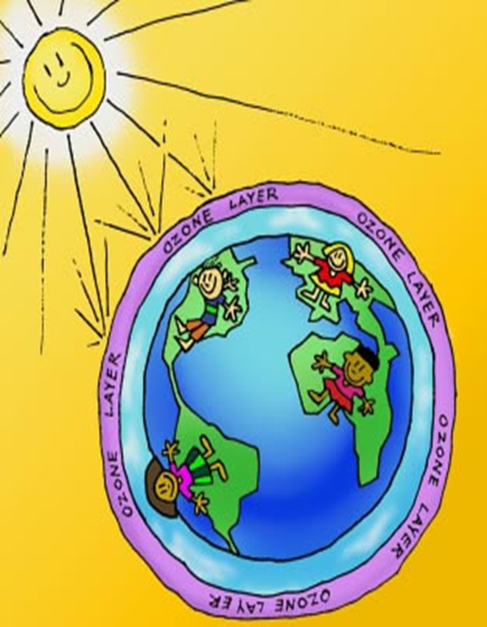
What is ozone ???
Notes:
What is ozone

Slide 4
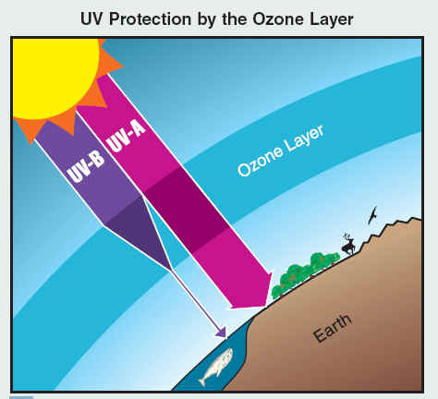
The ozone
The ozone layer is a layer in Earth's atmosphere which contains relatively high concentrations of ozone (O3).
Although the concentration of the ozone in the ozone layer is very small, it is vitally important to life because it absorbs biologically harmful ultraviolet (UV) radiation coming from the sun.
O3 is mainly found in the stratosphere.
O3 both heats the stratosphere by absorbing UV and is a greenhouse gas (absorbing and emitting in the Infrared).
Notes:
What is ozone???Ozone is a triatomic form of oxygen (O3) a no of ozone molecules come together at high conc they form the ozone layer. This layer absorbs 97–99% of the Sun's high frequency ultraviolet light, which is damaging to life on Earth.

Slide 5
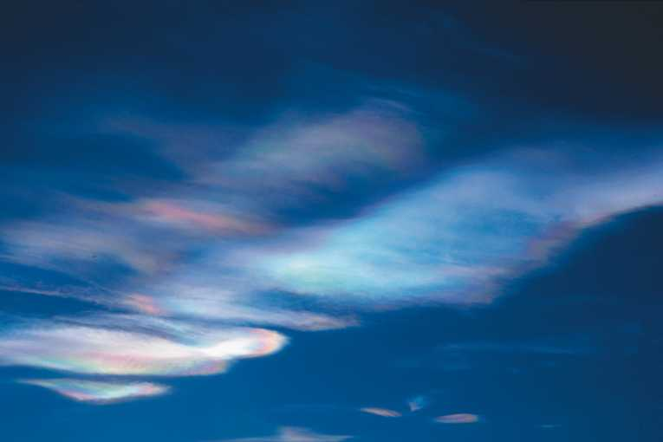
Ozone Depletion
Ozone Depletion; Destruction of the stratospheric ozone layer. This destruction of ozone is caused by the breakdown of certain chlorine and/or bromine containing compounds (chlorofluorocarbons or halons), which break down when they reach the stratosphere and then catalytically destroy ozone molecules.
A worrying rate of ozone depletion is found above the Arctic.

Slide 6
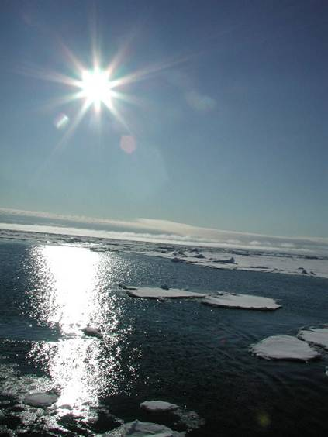
Ozone destructions and it’s impact

Slide 7
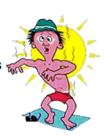
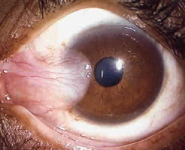
Too much ultra-violet-b on human beings
Skin cancer:90% of the skin carcinomas are attributed
Eye damage such as cataracts : Increases the risk of cataracts
Induces type of protein that provokes cleaving (splitting) in the lens
Leading cause of blindness
The prevalence of cataract after age 30 is doubling each decade
Immune system damage : Enhanced susceptibility to infection
Notes:
Ozone destruction impact
On human beings : over exposure can cause skin cancer, and can also cause cleaving in the lens and also can damage retina cells leading to blindness. They can also cause damage to immune system making human body vulnerable to various diseases.

Slide 8
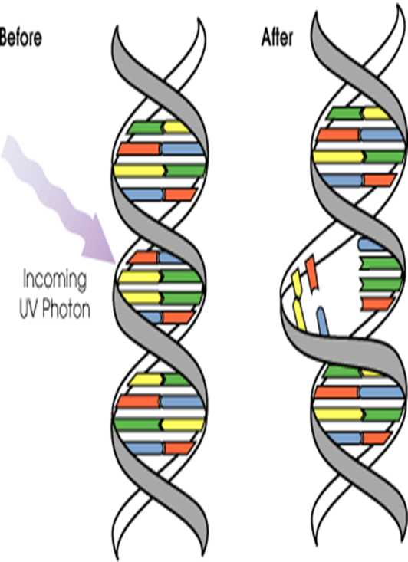
Dna and uv
DNA absorbs UV-B radiation
Changes shape in DNA
Changes in the DNA molecule mean that enzymes cannot “read” the DNA code
Results in mutated cells or the cells die
Cells have developed the ability to repair DNA
A special enzyme arrives at the damage site
removes the damaged section of DNA
replaces it with the proper components
This makes DNA somewhat resilient to damage by UV-B
Notes:
Dna and UV ray’s : When Dna is exposed to UV- b rays it absorbs these rays resulting in change of dna shape further resulting in creation of mutated cells and dying of cells. But if the UV-b ray exposure is low then a special enzyme gets created which can repair the damage.

Slide 9
The influence of the UV-b radiation on plant process. In experimental series the following observations were determined: number of leaves, tillering of plants recorded after three weeks and before harvest plant height, biomass of plants, specific leaf weights leaf: shoot dry ratio, shoot dry matter of chlorophyll. Leaf area was measured using a LI COR LI-30004 portable leaf area meter and the content of total chlorophyll was measured with a Minolta SPAD-502 meter5.
Notes:
Influence of uv-b radiation on plants growth : To find effect of Uv-b radiaton on plant growth experiments were conducted in which similar plants species were made to grow exposed to various UV conc. And it was found that the plant which was most exposed to UV radiation was found to have stunted growth and chlorophyll content was found to be very low thus hindering photosynthesis.

Slide 10
Summary
Ozone is the critical gas for screening solar UV radiation. Quality, long-term observations are critical for assessing change!
Ozone loss resulted from human produced ozone destroying substances (ODS: CFCs ). These chemicals have extremely long lifetimes.
ODSs have been regulated under international agreements and are slowly decreasing.
Ozone levels are not getting worse, but we can’t say that things are getting better (yet).
The ozone hole will recover by about 2068.
Notes:
Ozone layer is very much vital to human beings. It absorbs most of Uv radiations . Ozone loss by human produced chemicals such as Cfc’s have caused serious damage to human beings and various other living organisms. Though the present rate of recovery of ozone is very low , things are still getting better . And if the effort to protect the ozone is continued ozone is said sure to recover by 2068.
Thank you

Slide 11
Thank you
Made and presented by :- 130150106101
130150106120
130150106032
130150106005………

